Slide 1


Blending Generative Models with Deep Learning for Multidimensional Phenotypic Prediction from Brain Connectivity Data
Thesis Defence : Niharika S. D’Souza
Primary Advisor : Dr. Archana Venkataraman
Thesis Committee: Dr. Archana Venkataraman, Dr. Amitabh Basu, Dr. René Vidal, Dr. Stewart Mostofsky, Dr. Kilian Pohl
November 12th,2021
Notes:
Hello everyone, my name is Niharika. Welcome to my defense talk. Thank you to all of you for being here . I am a PhD student at the department of Electrical and Computer Engineering at Johns Hopkins University.
My advisor is Dr. Archana Venkataraman. My work has centered around developing better representational frameworks for computational neuroimaging data. To this end, we leverage ideas from machine learning, optimization, geometric frameworks and generative modeling. From the clinical standpoint, we wish to bridge these representations from connectomics with those of behavioral phenotypes in a predictive setting. Our primary motivation is to improve our understanding of complex neurodevelopmental disorders such as Autism Spectrum Disorder, beyond a simple diagnostic classification. We have been working closely with researchers at the Kennedy Krieger Institute at the Johns Hopkins Hospital. With that brief introduction, let’s dive right in

Slide 2
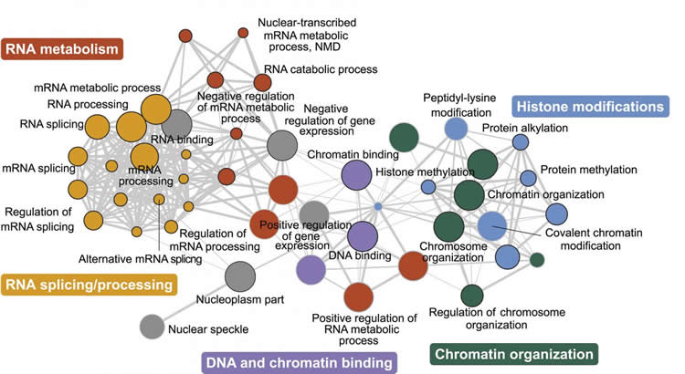

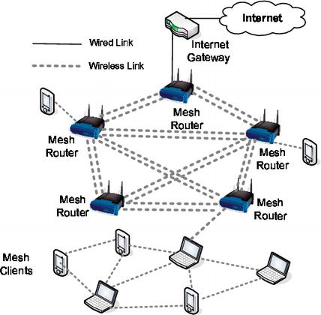
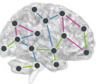
Network Analysis in the Real World
Genetics Networks
Social Network- e.g. Facebook
Wireless Networks
The human brain
Notes:
We live in a world which is naturally organized into intrinsic network structures.
<click> For example, at the biological scale of organization lies the human genome. Here, various encoding proteins interact with each other in complex ways and define characteristic human traits.
<click> On the other hand, the age of the internet has given rise to complex social networks such as the ones on facebook. These have been shown to have tremendous power in influencing people’s decisions at an individual level. <click>A wireless network is another example, where various devices communicate with each other point to point. The study of networks is thus very relevant in the modern world, as we gain a lot of insight into otherwise mysterious phenomenon. <click>In fact, one such complex network is the human brain. Recently, there has been a lot of interest in understanding how regions in the brain communicate with each other and how these communication patterns influence our behavior and health. This sets us up for an important, yet really challenging question.

Slide 3
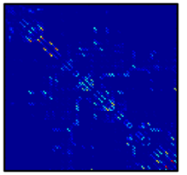
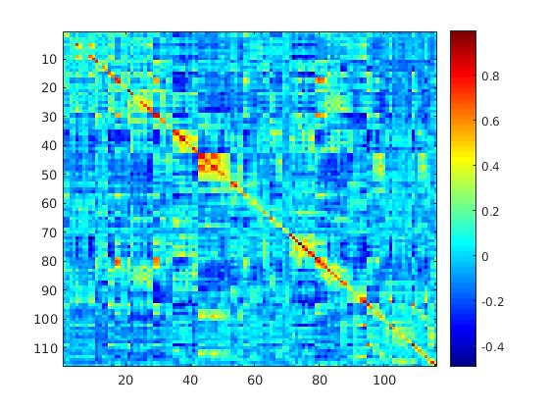
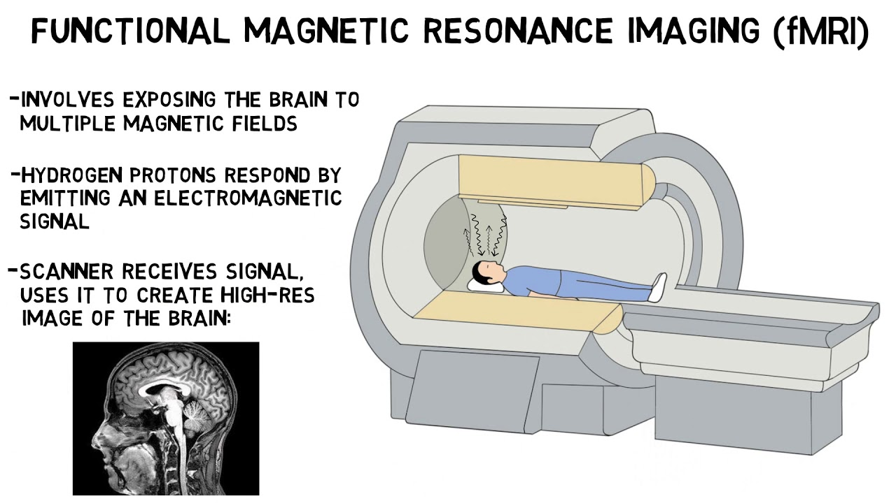
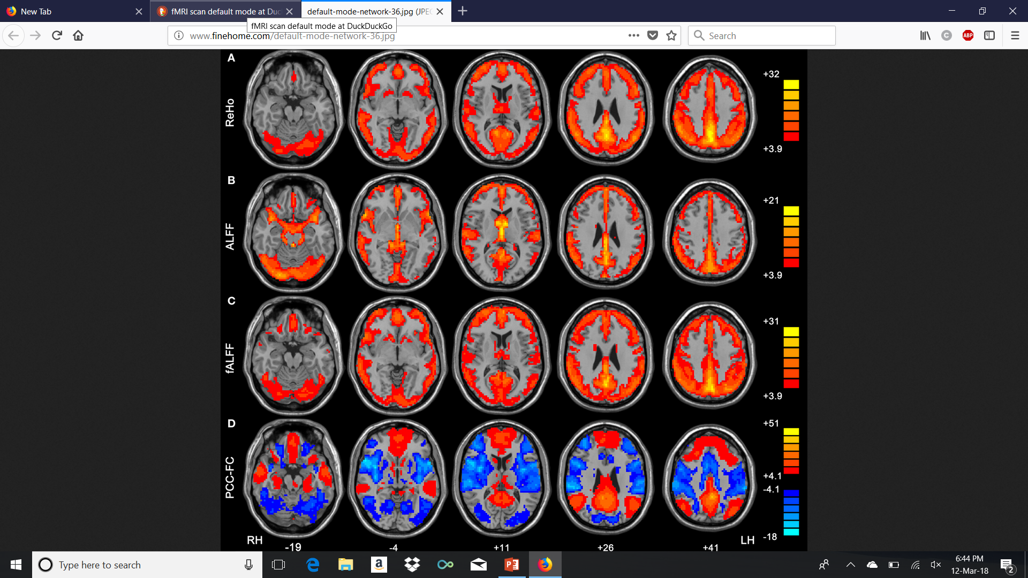
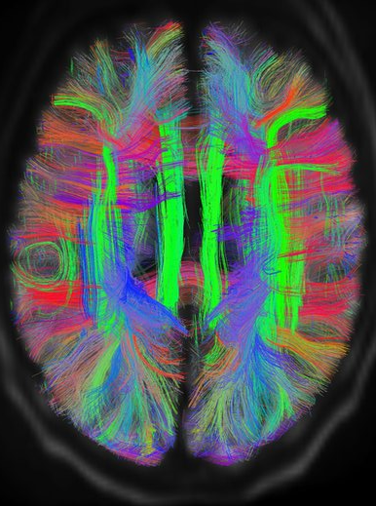
Exploring Brain Connectivity
Structural Connectivity
Functional Connectivity
Diffusion Tensor Imaging
(DTI)
Resting-State Functional MRI
Functional Connectivity
Notes:
The human brain is a vital organ that co-ordinates key information and plays a critical role in decision making.
<click>Anatomically, it is a network of individual processing centers interconnected by neural axons.
<click> Functionally, the brain partitions itself into a myriad of regional hubs that specialize at complex and sometimes abstract tasks.
<click>In this thesis, we explore this duality in representation via structural and functional neuroimaging data, as given by Diffusion Tensor Imaging (DTI) and resting state functional MRI (fMRI) acquisitions. This figure illustrates connectivity based views of function and structure respectively, which we use to study brain organization.

Slide 4

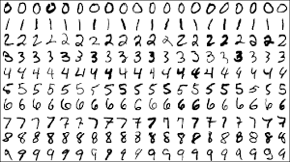
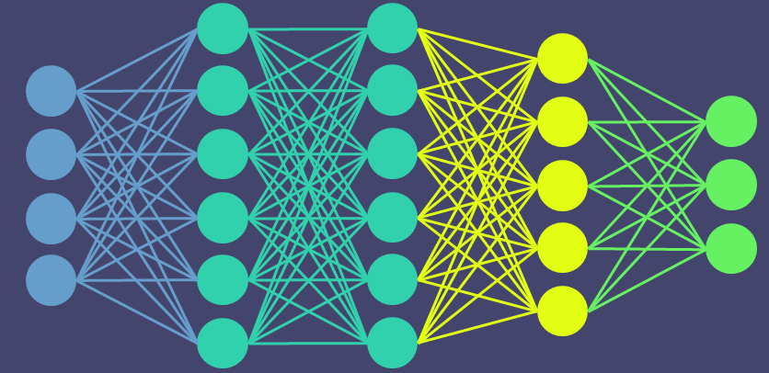
Brain Connectivity: A Data-driven Perspective
Age of Data-Driven exploration: Compute Power meets Big Data
AI for Clinical Neuroscience:
Challenges:
Small datasets: Costly acquisitions
Complexity: Subtle differences, patient heterogeneity
Notes:
From the algorithmic and computational perspective, we have been witnessing an explosion in terms of data-driven methodologies. This is largely fueled by phenomenal increase in compute power along with the curation of large datasets such as MNIST, ImageNet etc. <click>In this regard, datasets for medical imaging studies lie on the other end of the spectrum. This is particularly pronounced for neuroimaging studies, such as the applications that I will talk about in this thesis. While a typical computer vision or speech dataset may have over tens of thousands of examples, here we are look at something of the order of 50 patients, which is a much reduced sample size.
At the same time, this data also has a lot of complexity in terms of the underlying interactions within the brain. For example, differences in brain connectivity tend to be very subtle, especially in disorders such as schizophrenia and autism. At the same time, directly aggregating data from multiple sites is challenging due to differences in acquisition and population demographics. As a result, many clinical studies remain modest in terms of dataset size.
To summarize, there is often a lot of heterogeneity within patient populations, which many models fail to capture. It is imperative to develop frameworks which can effectively tease individual differences from limited data and this is where my research comes in <pause>

Slide 5
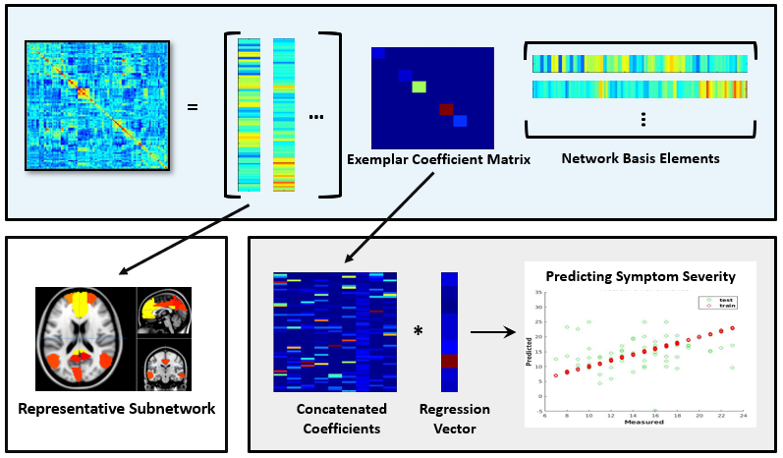
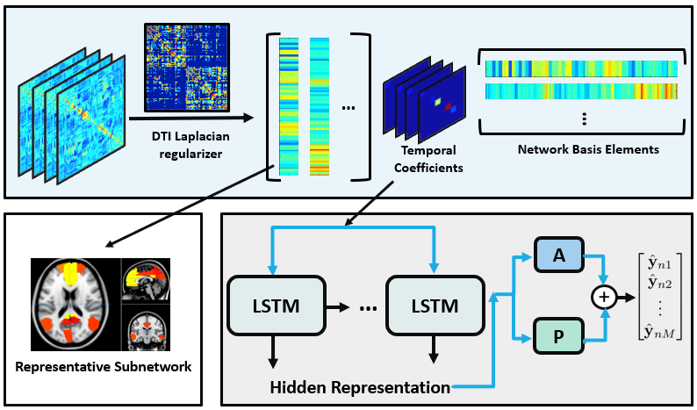
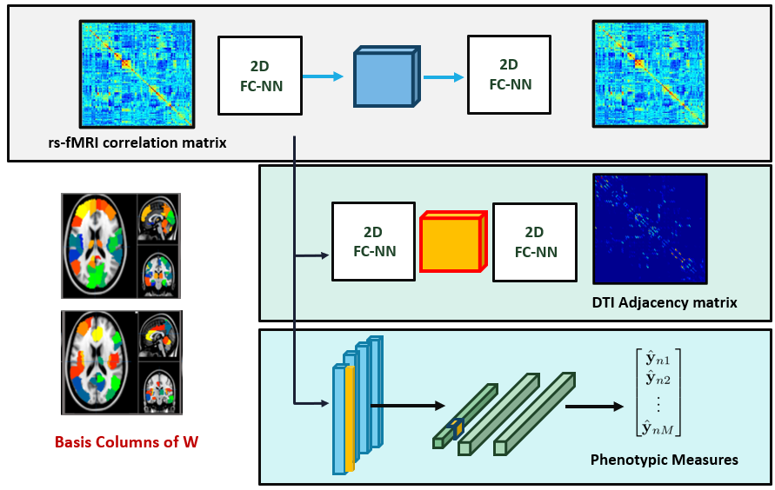
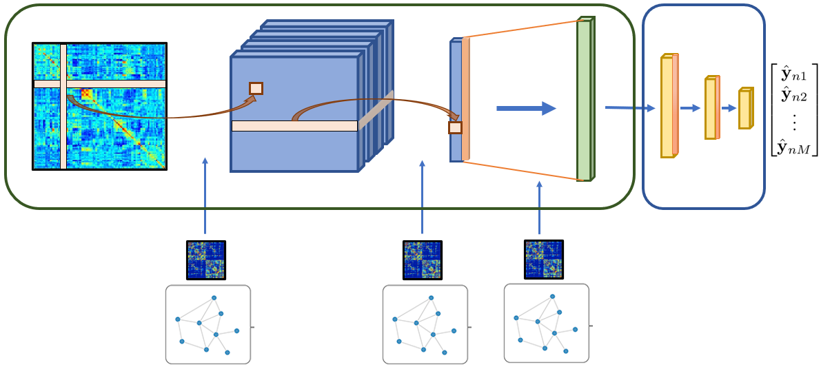
Part I
Part II
Part III
Part IV
Notes:
Overall, I have organized my talk into four parts. In the first two sections, I will build up frameworks that can jointly model functional and structural connectomics data and predict behavioral measures in clinical populations.
The last two segments of the talk focus on geometric modeling extensions that leverage deep learning techniques for better better understanding neuroimaging data and clinical information. <click> In the first section, I will describe the generative-discriminative framework we developed. This is designed to automatically extract brain networks from functional connectivity data that are predictive of behavioral measures.

Slide 6
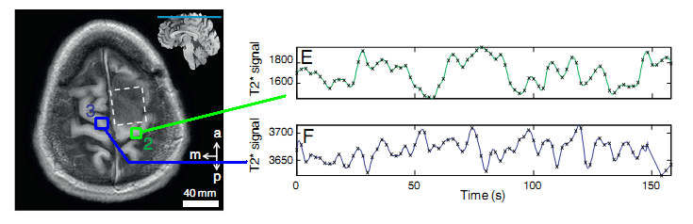
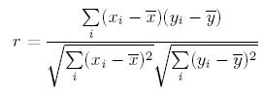
Background: Functional Connectomics
4D rs-fMRI scan data
Analysis
Latent Functional Organization
Correlation matrices
Symptom Severity
Pearson’s correlation coefficient
Average Time Courses
Patient correlation matrix
Notes:
A typical resting state functional MRI scan requires the patient to lie still in the scanner while being imaged. The resulting acquisition is such that each volume element or voxel has a time series response associated with it. <pause> The underlying rationale is that brain regions which communicate with each other display synchrony in terms of their activation. To characterize these functional relationships, we often use correlation matrices. <click>
These capture the similarity between responses across different brain regions. For example, a commonly used measure is the Pearson’s correlation coefficient, which makes these matrices symmetric along the diagonal.
<click>What we wish to infer from this, is the latent functional organization in the brain. <click>Further, we want to utilize this information to examine symptom severity associated with a disorder. Often, this symptom severity is a numerical measure that is scored by a clinician and indicates the level of impairment in a patient. <click> Now, a typical machine learning setup for this problem would use features corresponding to the upper triangular part of the correlation matrix for each patient.

Slide 7
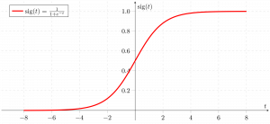
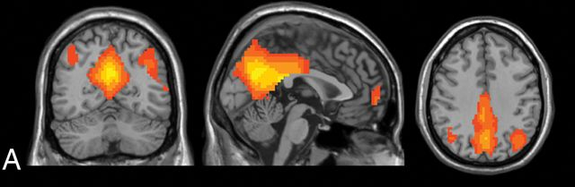
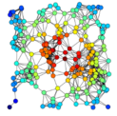
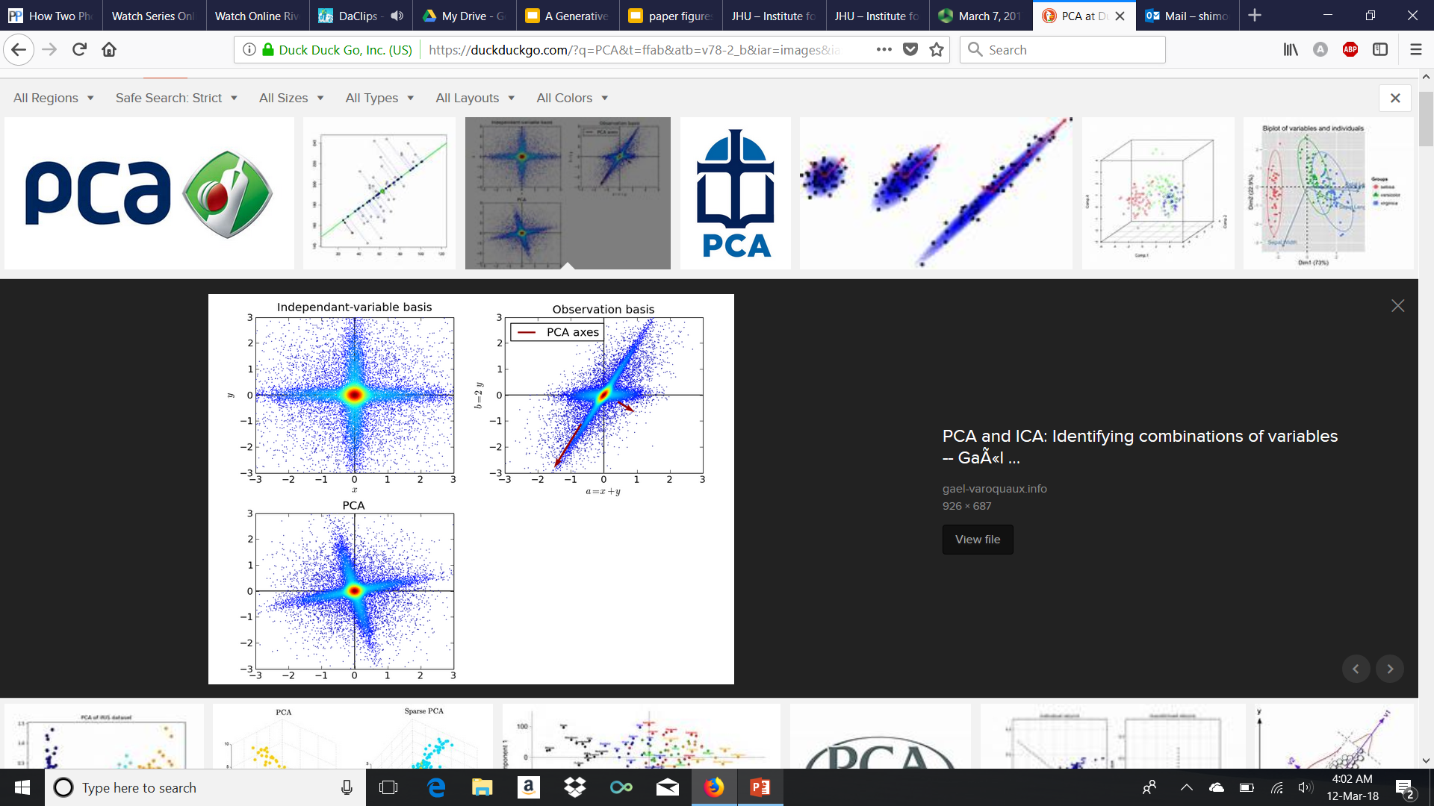
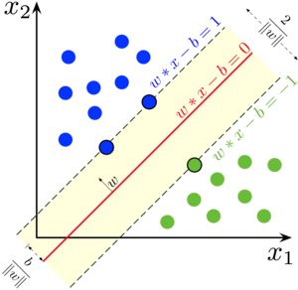
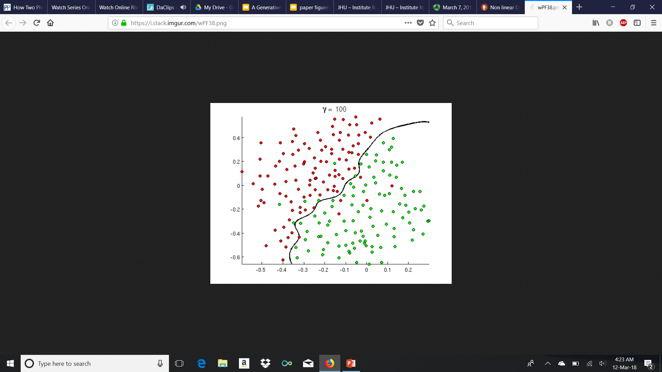
Machine Learning Analysis for Clinical fMRI
Dimensionality Reduction
Classification
Correlation Features
Diagnosis
ICA
Centrality Measures
Modes of variation
Logisitic
SVM
Random Forests
Limitations: Pipelined treatment and focus heavily on group-level discrimination
Machine learning in resting-state fMRI analysis, Khosla et al 2019, Magnetic Resonance Imaging
Notes:
Let’s look at how a typical machine learning pipeline looks like. It’s important to note that the vectorized correlation features are of the order of a 1000s depending on the parcellation of choice. This is fairly large compared to the number of patients in the study. <click> Thus, a natural first step is to perform dimensionality reduction to compactly represent this information, yet retain salient information. Commonly, ICA , or centrality measures, or statistical approaches such as PCA may be used here.
Once the representation is brought to a more manageable space, the projected features are then fed into a discriminative model <click> that predicts clinical diagnosis. Again, we could use a simple linear or more complex non-linear model.
<click>While such frameworks have widely been used for this task, a main disadvantage is that the approaches are pipelined. Effectively, what that means is that if our dimensionality reduction is off, we cannot hope to get a meaningful representation for the downstream task. Additionally, most of literature focuses on the classification task. This effectively groups all patients into the same class and performs group-level discrimination. However, these disorders are known to be pretty heterogenous. This means that although there are group level commonalities that arise from these disorders, there are also subtle differences in how two different individuals manifest symptoms. Most existing frameworks are unable to model these effects simultaneously.

Slide 8
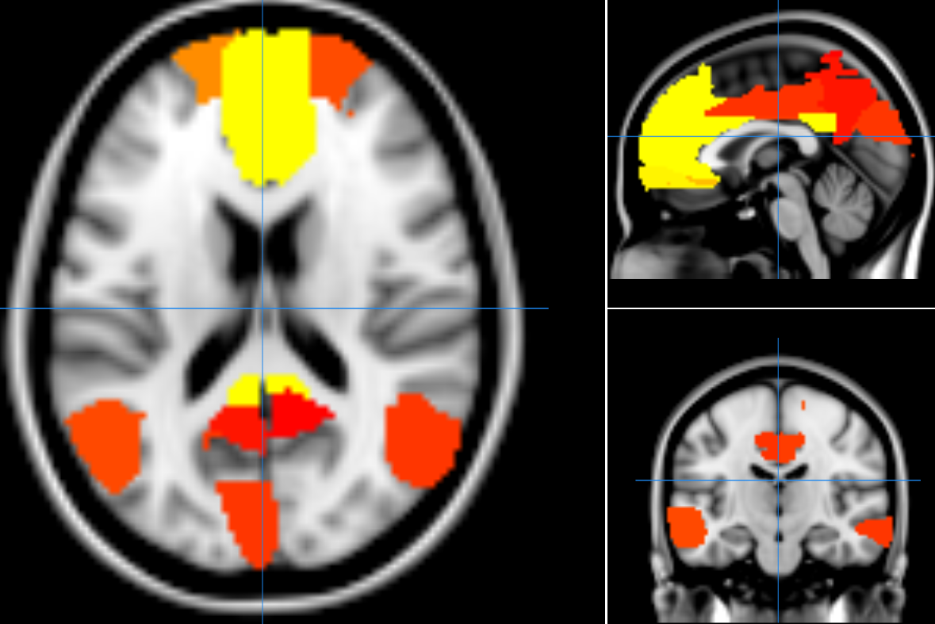
Joint Model for Connectomics and Severity
Patient Specific Information
Generative Model
Group Level Information
Regression Model
Clinical Severity
Discriminative Model
Representative Subnetwork
Notes:
These limitations motivates our joint model. <pause>
Our model has two parts: the first is a generative model. It simultaneously accounts for group level as well as patient specific information from patient correlation matrices. The group level canonical representation can be mapped back to the brain, and is shared among patients. From here, the patient specific term feeds into a discriminative regression framework to predicts clinical severity. Instead of the pipelining the two, we will jointly infer the generative and discriminative representation within the inference.

Slide 9
Joint Model for Connectomics and Severity
Patient Specific Information
Generative Model
Group Level Information
Regression Model
Clinical Severity
Discriminative Model
Representative Subnetwork
Notes:
Now that we have a high-level picture, let us first look at the blue box representation in detail

Slide 10
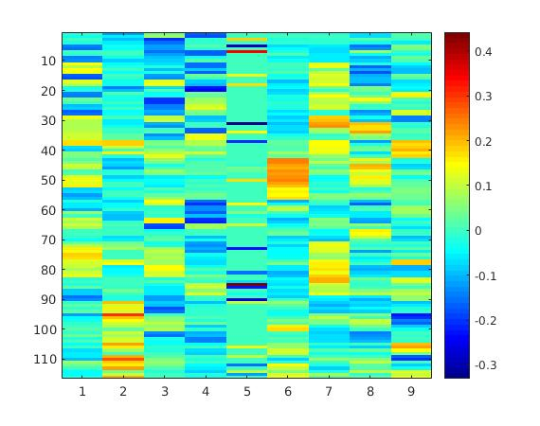
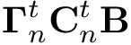
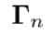
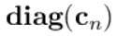
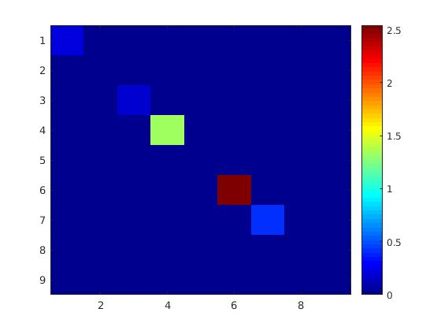
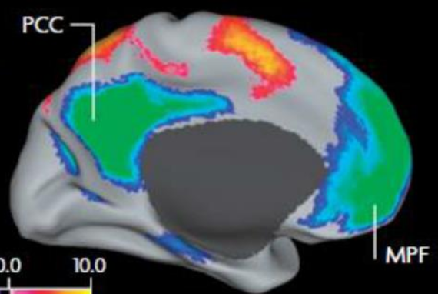
Dictionary Learning for Connectomics
=
…
*
*
…
Subnetwork Basis
Patient Network Strength
Exemplar Subnetwork
Notes:
We begin with the correlation matrix for each patient: gamma n.
<click>The group level term is a basis matrix B. The columns capture co-activation patterns in the brain that are common to all the patients. This can be seen in this exemplar subnetwork. <pause> Although the subnetworks are the same for each patients, the way in which these combine to explain the patient correlation matrix are individual-specific.
<click>We capture this by patient specific diagonal network strength matrix here. <click> This combines the subnetworks using an outer-product to explain each patient’s correlation matrix.
This dictionary decomposition is similar to common principal components, and ties in with our motivation of capturing group level and patient specific information simultaneously. Intuitively, we are trying to model the functional communication in the brain via distributed and spatially overlapping sub-systems.

Slide 11
Joint Model for Connectomics and Severity
Generative Model
=
…
…
Exemplar Coefficient Matrix
Network Basis Elements
Regression Model
Clinical Severity
Discriminative Model
Notes:
Next, we will look at the discriminative model in the gray box

Slide 12
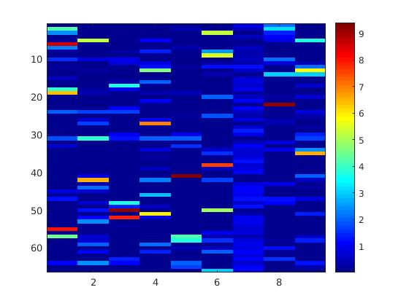
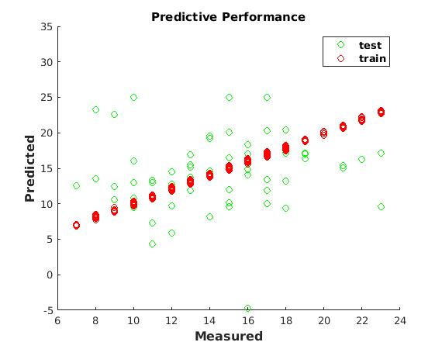
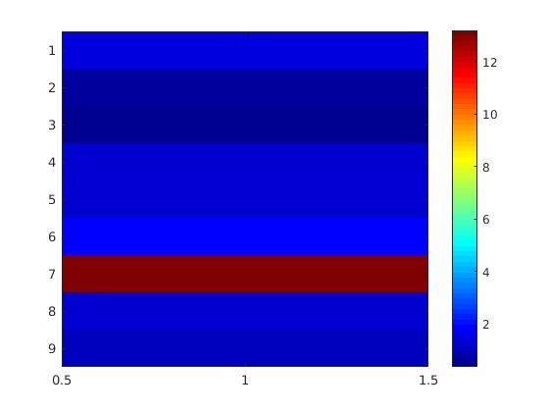
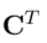
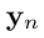
Clinical Severity Prediction
N patients
*
=
K networks
K networks
Coefficient Matrix
Regression Weights
Symptom Severity
Notes:
Using patient’s diagonal network strength, we stack these coefficients into a matrix C. <click> It has K networks and N patients. Each row of this matrix represents a patient. Typically, we use a small number of networks that capture the information most faithfully, effectively reducing the dimensionality of the fMRI data. <click> From here, we then use a linear regression with weight matrix w to predict clinical severity. This is a single clinical measure per patient and is captured in the vector y

Slide 13
Joint Model for Connectomics and Severity
Generative Model
=
…
…
Exemplar Coefficient Matrix
Network Basis Elements
Predicting Symptom Severity
*
Discriminative Model
Representative Subnetwork
Concatenated Coefficients
Regression Vector
Dsouza NS et. al. A generative-discriminative basis learning framework to predict clinical severity from resting state functional MRI data, MICCAI 2018
Dsouza NS et. al. A joint network optimization framework to predict clinical severity from resting state functional MRI data, Neuroimage 2020
Notes:
These are the constituents of our joint model. This work first appeared in MICCAI in 2018 and an extended version is available in our 2020 NeuroImage paper.
<pause> We refer to this as our joint network optimization framework or JNO for short. In the following slide, we will mathematically formalize this:

Slide 14
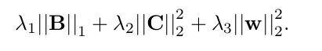
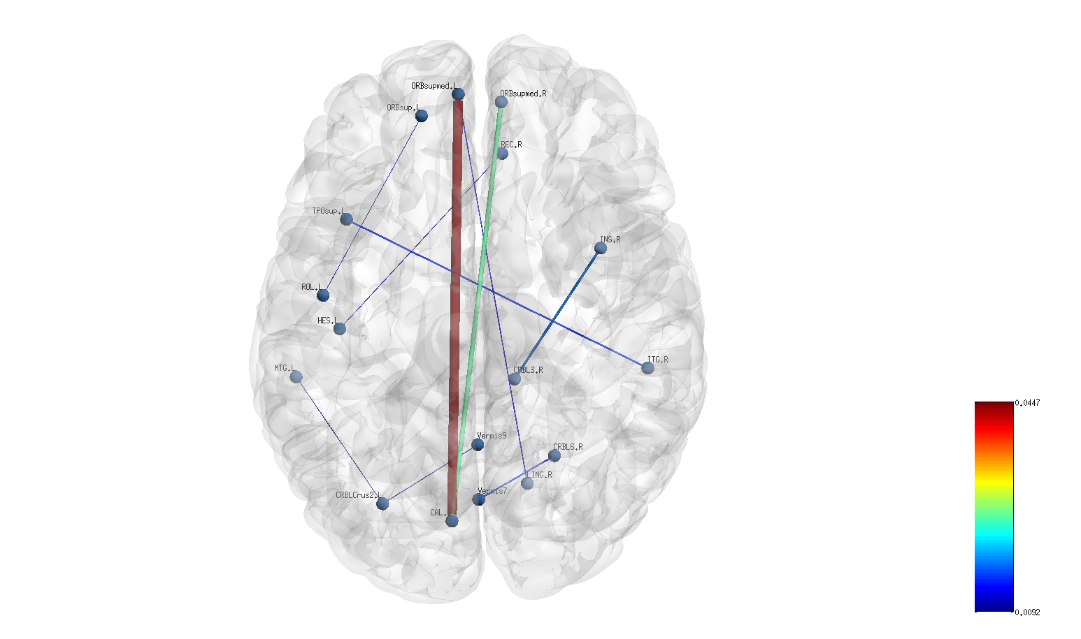
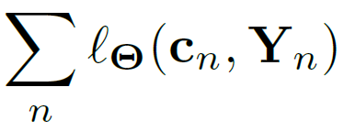

Joint Model: Optimization
Matrix Factorization
Clinical Severity Prediction
Non-negativity Constraint
Inputs:
Correlation Matrix
Severity Score
Generative Term
Discriminative Term
Unknowns:
Basis
Patient coefficients
Regression weights
Sparsity Penalty
Quadratic Regularisers
Alternating Minimization
Update via proximal gradient descent
Quadratic programming for
Closed for solution for
Exemplar sparse edge graph
Notes:
We have a joint objective function with two main terms, <click> the first for the matrix factorization <click>described by the blue box, <click> and the second for the clinical score prediction – the grey box <click>. <click>We add an additional l1 penalty on the basis B to encourage sparsity and highlight important brain regions.<click>
<click> We add an additional non-negativity constraint on the c’s since the Gammas are positive semidefinte. <click>
<click>We add additional l2 penalties to ensure that our estimation problem is well posed. <click> <click> The inputs to training this model are the correlation matrices and scores.
<click>The unknowns we are trying to estimate are the basis, the coefficients and regression weights Note that we are jointly trying to infer these latent variables To simplify the estimation, we can notice that the subproblems in each of these variables can be tackled more easily <click> Hence, we develop an alternating minimization scheme with three main steps.
Fixing c and w, we can use proximal gradient descent to update B. This handles the l1 penalty. <pause>
The objective is quadratic in c and convex, so we can utilize quadratic programming solvers. <pause>
Finally, w has a closed form solution. <pause>
We cycle through these steps until we reach a notion of overall convergence. To summarise what we are try to do here, is to obtain a joint representation that explains the connectivity data and clinical severity simultaneously.

Slide 15
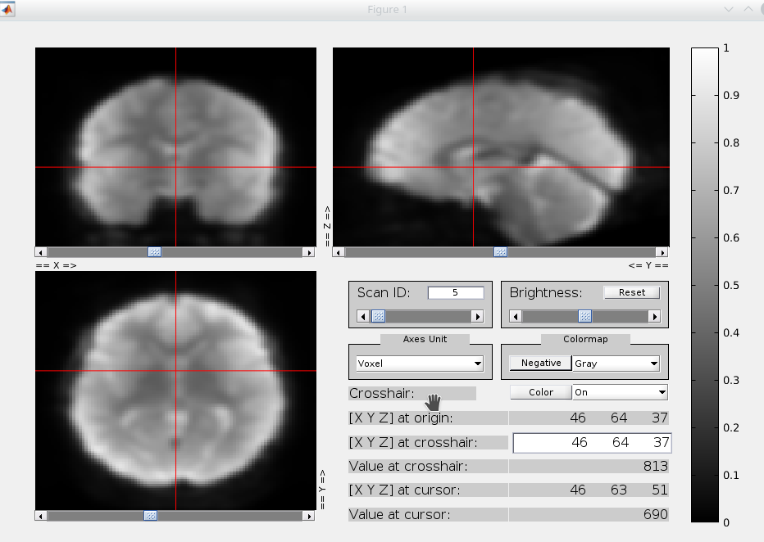
Dataset
Neuroimaging Domain: rs-fMRI scan data for 58 ASD patients
Behavioural Domain:
Score | Dynamic Range
ADOS | 0 - 30
SRS | 70 - 200
Praxis | 0-100
ADOS: socio-communicative deficits with restricted/repetitive behaviors
SRS: impairments in Social Responsiveness
Praxis: motor/gesture-command/imitation
Notes:
To evaluate this model, we have rs-fMRI scans collected for 58 patients with Autism Spectrum Disorder or ASD. As mentioned earlier ASD results in diverse clinical impairments. <click> In this study, we validate our model on three separate clinical measures. <click>The first of these is ADOS. It captures socio-communicative deficits along with restricted /repetitive behaviors, and is scored by a clinical exam. <pause> The SRS measure quantifies social responsiveness and is a parent/teacher questionnaire.
Finally, Praxis is a motor measure in which trained clinicians score individuals based on imitation, gesture to command and tool usage. Overall, these measures quantify a wide range of diverse impairments characterizing the disorders and employ different methods of reporting. This contributes to the heterogeneity of the cohort, which our models are trying to characterize.

Slide 16
Evaluation: Cross Validation
train
PCA + RF Regression
kPCA + RF Regression
Our Method
y_{train}
Training evaluation
Model Parameters
Deployment on test data
test
Patient Correlation Matrices
y_{test}
Testing evaluation
Notes:
We perform a k fold CV for our methods, and the baselines, where we train the model on a percentage split of the data to estimate the model parameters – which is our case are the hidden variables in the model and test on the unseen patients. <pause> We compare against two separate machine learning baselines. The first performs a linear dimensionality followed by a random forest regression. The second is non-linear dimensionality reduction, followed by a random forest regression. Both baselines emulate the pipelined approaches mentioned previously

Slide 17
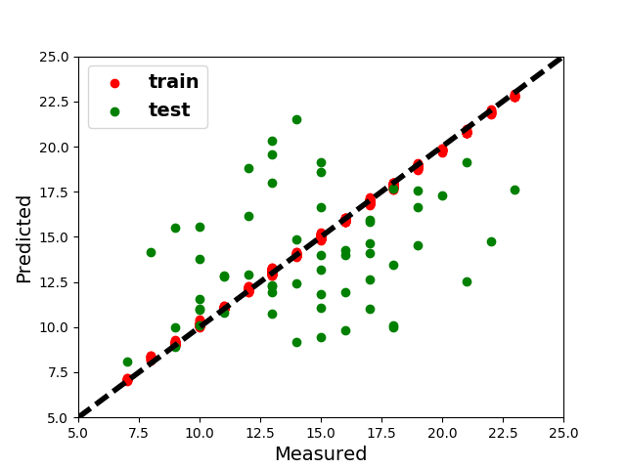
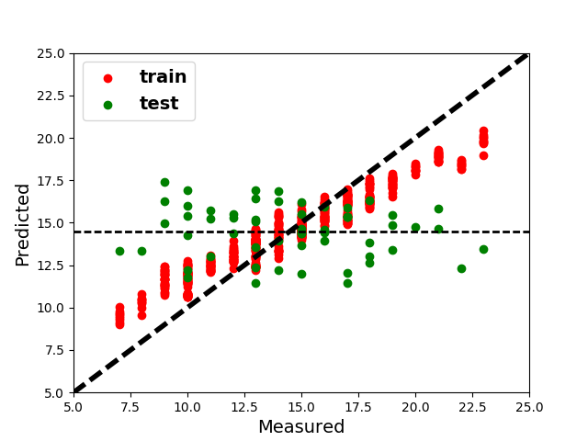
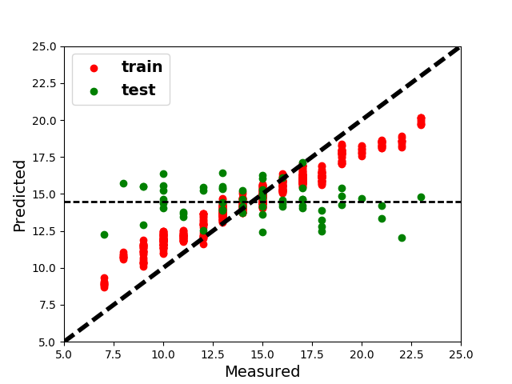
Regression Performance - ADOS
JNO Framework
PCA + RF Regression
k-PCA + RF Regression
Test MAE: 2.28
Test NMI: 0.52
Test MAE: 2.78
Test NMI: 0.37
Test MAE: 2.99
Test NMI: 0.30
Graph Theoretic + RF Regression
RF Regression
Notes:
We first look at the prediction of ADOS. To the left is our model, PCA+RF in the center, and k-PCA and RF is at the extreme right.
The x axis describes the score given by the clinician with the score predicted by the model on the y axis. Thus, ideal performance should be given by the x=y line. The red points indicate training fit, and the green ones denote prediction on held out testing data. As for the training data, all methods fit very pretty well. However, when it comes to unseen data, the baselines fail to generalize. In fact, they are not able to detect differences between patients, and typically concentrate around the mean. Unlike this, our method is better at capturing trends in unseen patients. This is also quantified by the median absolute error, and the mutual information metric.

Slide 18
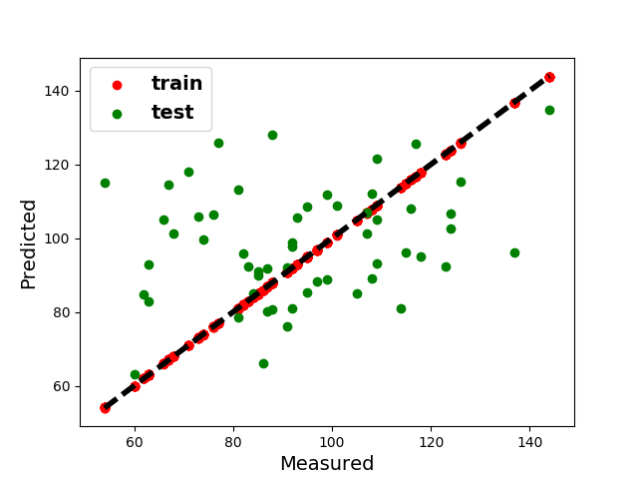
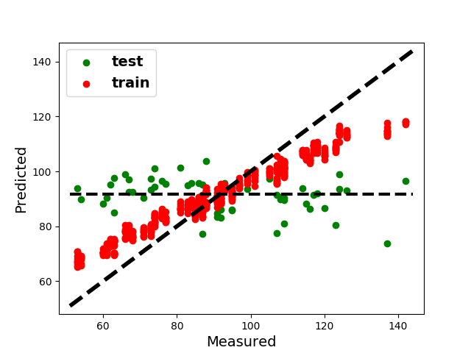
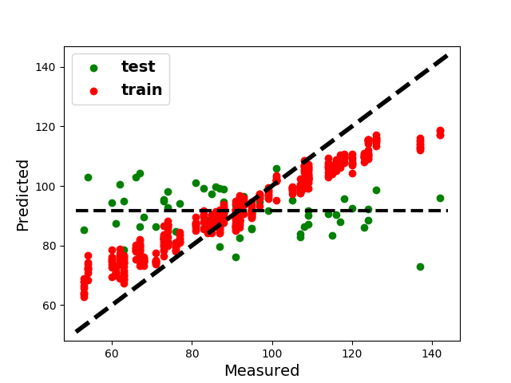
Regression Performance -SRS
JNO Framework
PCA + RF Regression
k-PCA + RF Regression
Test MAE: 13.27
Test NMI: 0.78
Test MAE: 18.60
Test NMI: 0.52
Test MAE: 19.20
Test NMI: 0.49
Outliers
Notes:
The performance difference can also be seen on the SRS prediction in both the qualitative and quantitative performance.
<click>Our method too isn’t perfect either, as there are some outlying points. At the same time, this should be expected in a sense, given score reporting itself can contribute to some of this variability.

Slide 19
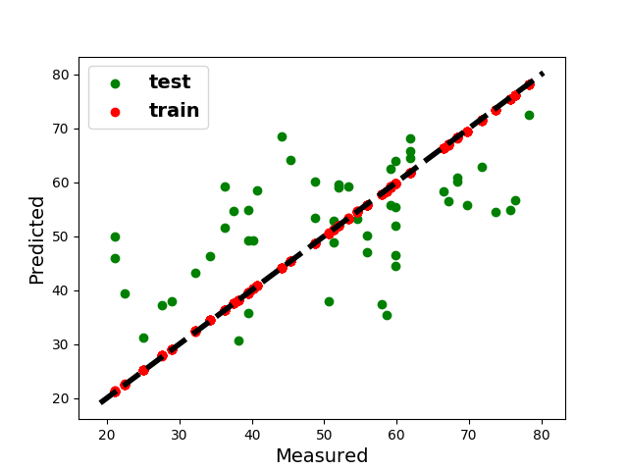
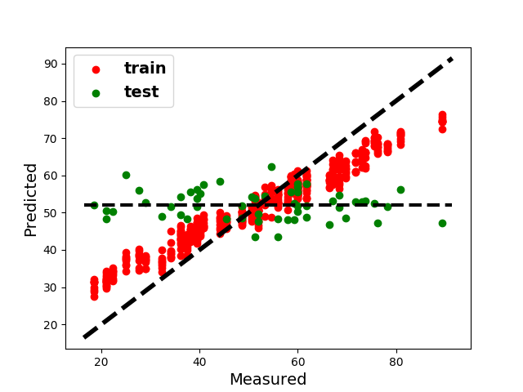
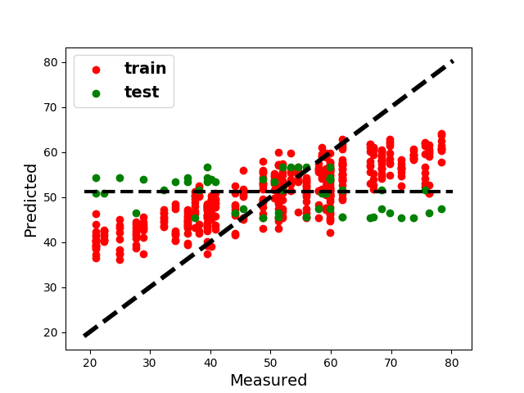
Regression Performance - Praxis
JNO Framework
PCA + RF Regression
k-PCA + RF Regression
Test MAE: 10.18
Test NMI: 0.79
Test MAE: 12.18
Test NMI: 0.58
Test MAE: 12.40
Test NMI: 0.52
Outliers
Graph Theoretic + RF Regression
RF Regression
Notes:
We observe a similar performance for Praxis.
Overall, the performance profiles indicate the difficulty of the prediction task itself. While all methods have representational capacity to fit the training data, we conjecture that the baselines lack the flexibility to learn representations that are predictive of clinical severity. In contrast, our optimization procedure is designed to uncover a representational space that is directly informative of behavior.
We have more comprehensive comparisons in our NeuroImage where we compared this framework with several graph theoretic, machine learning, and statistical feature selection and regression models, which our model outperforms.

Slide 20
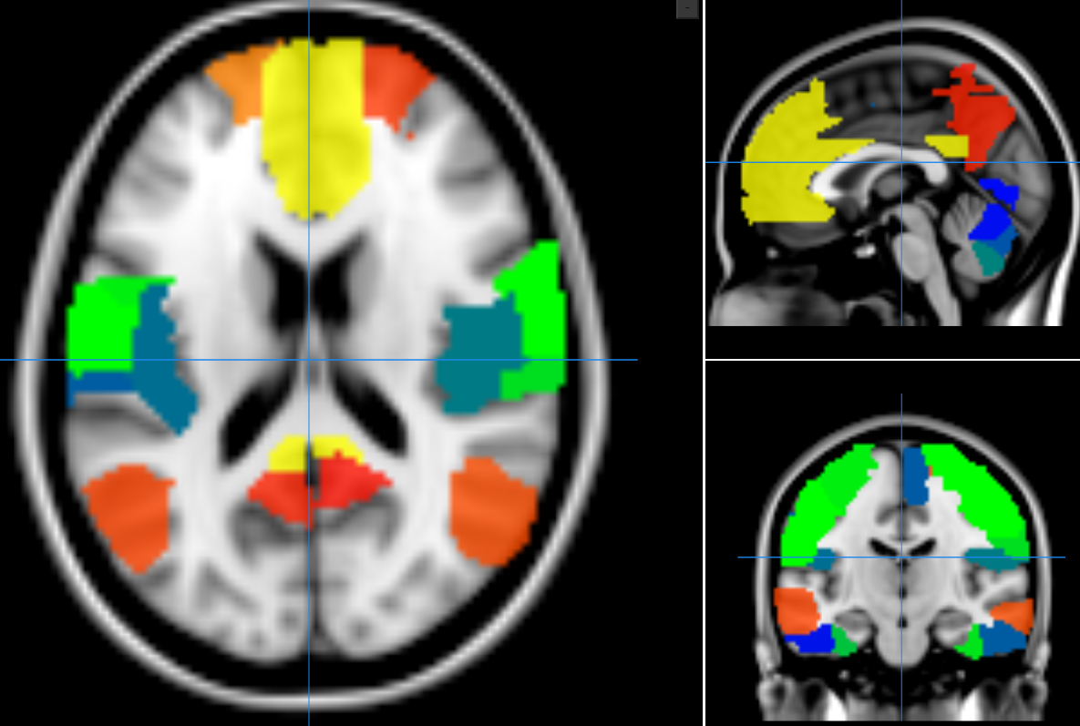
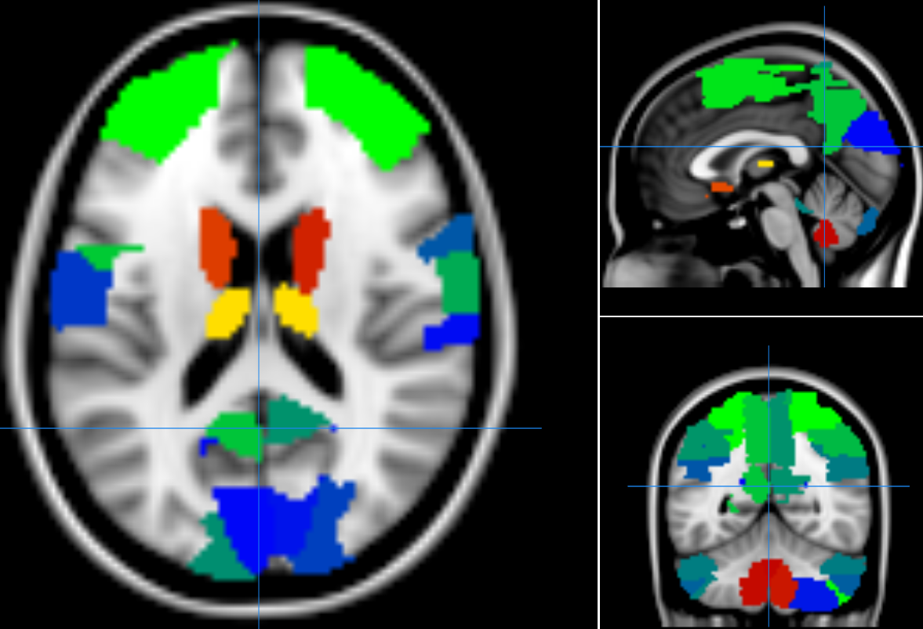
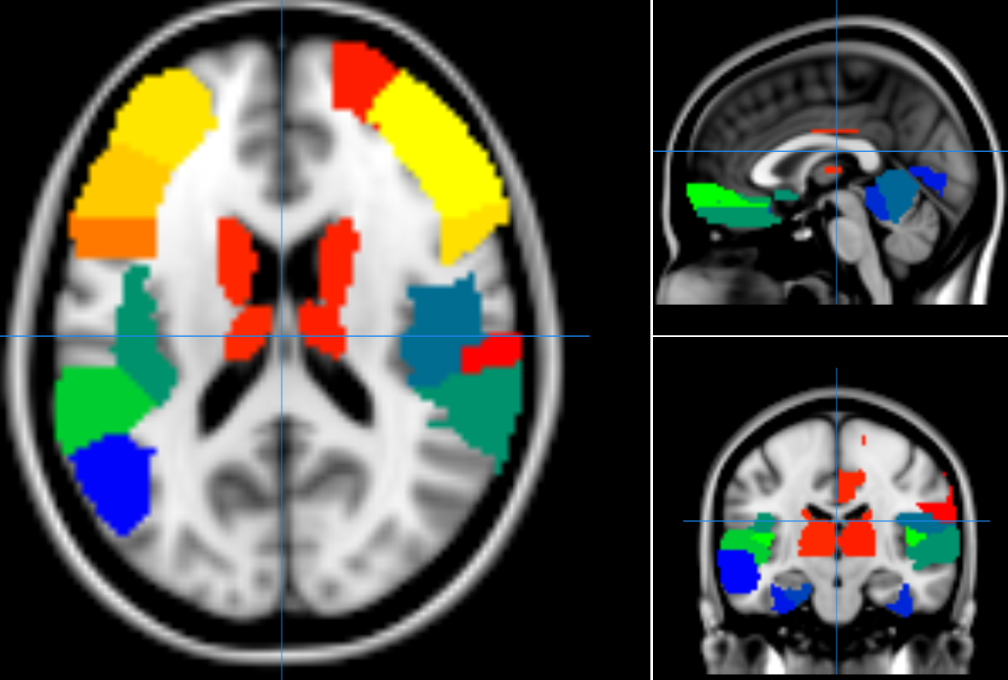






Basis Subnetworks – (ADOS)
0.23
0.03
Subnetwork 1
Subnetwork 2
Subnetwork 3
Subnetwork 4
- 0.23
- 0.07
Subnetwork 5
Subnetwork 6
Subnetwork 7
Subnetwork 8
Notes:
Apart from predictive performance, we can also examine the co-activation patterns captured in the basis B. We illustrate the 8 subnetworks learned when the our model is trained to predict ADOS.
With the help of our clinical collaborators, we were able to identify that the learned patterns correspond to networks commonly seen within the ASD literature. This include the default mode network, somatosensory and visual networks. <pause>
The main takeaway is that the learned representation is of clinical relevance. It offers interpretability, as opposed to being black-box.

Slide 21



ASD Subnetwork Comparison
Overlap in representation
0.23
0.03
- 0.23
ADOS
SRS
Praxis
- 0.07
1. Default mode network in childhood autism: posteromedial cortex heterogeneity and relationship with social deficits Lynch et al, Biological Psychiatry (2013)
Notes:
Further, we can compare and contrast the patterns extracted for predicting various measures. For example, we illustrate one of the 8 subnetworks, for predicting ADOS to the left, SRS to the middle, and Praxis to the right.
This comprises of regions from the default mode network, which has been widely inferred in the ASD literature.
We see that there is a high level of overlap in the networks though they are trained against different scores. On one hand, it indicates robustness , since the framework is trained on the same fMRI scans in each case. On the other, the subtle differences in the basis patterns help adapt to the prediction of each individual measures. At a high level, the overlap suggests a common shared canonical representation, which can be useful for mapping the spectrum of behavioral deficits. Along these lines, we tried to extend this model to a multi-output linear regression. However, this did not perform well on predicting multiple deficits at the same time. We will address this limitation with the technical extension in part II.

Slide 22
Part I
A Joint Network Optimization Framework for Connectomics and Clinical Severity
Desiridata
Summary of Contributions:
Group level information common generative basis B
Reduces the dimensionality of rs-fMRI data
Interpatient variability Patient-Specific discriminative coefficients c_{n}
Predicting multiple deficits - heterogeneity (multi-score prediction)
Incorporating anatomical pathways
Incorporating temporal dynamics of rs-fMRI scans
Notes:
To summarise what we have seen so far, our model introduced a common generative basis which captures group level information, and also acts as a dimensionality reduction. Our discriminative coefficients capture heterogeneity in the population. Our joint optimization helps us extract generalizable and interpretable representations. <click> Some of the limitations we would have liked this model to address are listed here. <pause>
First, we would like to be able to learn a flexible representations that can explain multiple behavioral deficits simultaneously- this would help develop more holistic characterizations of complex disorders. We would also like our model to exploit complementary anatomical connectivity information. We can think of this approach as using prior domain knowledge in the form of structural connectivity to guide our functional representation. Lastly, this framework examines connectivity in the brain as a static snapshot averaged over the scan. However, literature suggests that functional connectivity is a dynamic process that evolves over time and space. Modeling this evolution can help improve our understanding of functional organization in the brain.

Slide 23
Part I
Part II
Part III
Part IV
Notes:
With that brief motivation, lets move to the second part of this talk. <pause> We extend the JNO framework by utilizing techniques from graph theory and deep learning to build a deep generative hybrid model.

Slide 24

Dynamic Functional Connectivity
Hidden Markov Models
(Eavani et. al, IPMI 2013)
Dynamic Conditional Correlation (Lindquist et. al, Neuroimage, 2014)
Time Varying Graphical Lasso
(Cai et. al., IEEE TBMI, 2018)
Notes:
First, we take a step back and take a second look at functional connectivity.
Over the course of the scan, it is believed that the brain toggles between different cognitively identifiable states. We represent this by this gif here. We see that the quote unquote states cycle through phases of activity and relative inactivity. <pause> This switching profile is unique to each individual, and is believed to be clinically informative. This is why we are interested in modeling this evolution
Prior work builds on techniques such HMMs that can encode and unravel transitions between latent cognitive states. Other approaches include the dynamic Conditional Correlation, and the graphical lasso, which propose various mathematical formulations to estimate dynamic connectivity. Most of these frameworks model interactions between large subsytems which are apriori grouped in the brain, and may not scale very well to a whole brain ROI level analysis. <pause> We circumvent this by adopting our generative model from the JNO to study sliding window correlations and estimate the underlying latent switching profiles.

Slide 25




Data-Driven Multimodal Integration
rs-fMRI
Patient Functional
Connectome
Rs-fMRI Feature Extractor
Diagnosis/Clinical Severity
DTI
Patient Structural
Connectome
DTI Feature Extractor
Separation Between Modalities: (Wang et. al 2011, Honey et. al 2009, Sun et. al. 2014)
- Compute statistics/centrality measures from rs-fMRI/DTI
- Draw correspondences post-hoc
Pipelined Approaches: (Wee et. al. 2012, Sui et al. 2013)
- First run feature extraction on the two modalities
- Train a discriminative/predictive model on extracted features
Notes:
Structural connectivity is often estimated using Diffusion Tensor Imaging or DTI. In a nutshell, it utilizes the directional diffusion of water molecules in the brain to estimate the fiber tracts that connect individual regions. Using tractography, we can construct detailed anatomical connectivity maps of the brain. Thus, structural connectivity provides information that is complementary to functional signaling.
There has been increasing interest in integrating the two representations, particularly for diagnostic applications. Here is how a typical data-driven multimodal integration pipeline looks. Often, such approaches follow two broad themes:
<click>Some techniques separately analyse the statistics from the individual modalities, or extract graph theoretic features separately, then draw correspondences between the features post hoc. <pause>
Such approaches may not directly exploit the complementarity between the two representations.
<click>Another common set of models combine the modalities in the same feature extraction module using data-driven techniques. Once these features are obtained, a discriminative model is then trained on them. Such approaches may suffer from the same limitations as discussed with the pipelined machine learning models discussed in Part I
We would like to address these limitations at a modeling level. Therefore, we propose a joint multimodal generative model. This integrates the fMRI and DTI connectomes together at the feature representation level. We also couple the generative model with a deep regression model into a single optimization.

Slide 26
Deep-Generative Hybrid
DTI Laplacian
regularizer
Patient Temporal Coefficients
Group Basis
LSTM-ANN
Multiple
Behavioral
Deficits
Representative Subnetwork
Notes:
We illustrate these ideas here.
The blue box describes our multimodal representation learning scheme on the NI data, while the gray box describes the deep network that maps to behavior.
<click> Let us look at generative model in detail

Slide 27


Dynamic Dictionary Learning
=
…
*
*
…
Subnetwork Basis
Temporal Patient Network Strength
Exemplar Subnetwork
Notes:
We begin with the dynamic functional connectomes Gamma n t.
<click> We again have a basis B which is common to all the patients. This is now shared across time as well. Again, each column captures shared co-activation patterns which map to the brain.
<click>However, the way these subnetworks combine, now over time, is unique to each patient. We capture this using temporal network strength term c n t.
We combine these subnetworks in an outer-product fashion to estimate the dynamic functional correlation matrices.

Slide 28



Structural Regularization: sr-DDL
structural regularization
…
*
*
…
Graph Laplacian
DTI data
Notes:
Our generative model is called the sr-DDL or structurally regularized dynamic dictionary learning. It builds onto this base representation.
<click>The DTI tractography matrices are graphs that describe anatomical connectivity between regions of the brain. In fact, it is believed that the functional relationships in the brain are mediated by either direct or indirect anatomical pathways. We would therefore, like to use this to guide our decomposition.
<click>We model the interplay via a structural graph regularization based on graph Laplacian operator. Mathematically, the graph laplacian is calculated as a scaled difference between degree matrix D and adjacency matrix A obtained from tractography.
Essentially, we will use this graph Laplacian L to re-weight the rs-fMRI matrix decomposition to shift focus to explaining patterns between anatomically connected regions.

Slide 29
Deep-Generative Hybrid
sr-DDL
…
…
DTI Laplacian
regularizer
Network Basis Elements
Temporal
Coefficients
LSTM-ANN
Multiple
Behavioral
Deficits
Notes:
The predictive part of our model is a deep-network in the gray box that maps to behavior

Slide 30




Deep Multi-Score Prediction
Predictor ANN
K nerworks
P
LSTM
+
+
A
T time
…
Attention ANN
Behavior
Hidden Representation
Patient Temporal Coefficients
Notes:
We first vectorize the diagonal contributions from the K network coefficients, as shown in the figure. The K networks are the rows, and the time points are the columns.
<click>Per subject, these column vectors c1 through Tn feed into an LSTM network. We want this to track the temporal evolution and estimates an embedding that predicts behavior.
<click>Thus, this embedding h is input into a two branched ANN, consisting of a predictor ANN and an attention ANN. <pause>The predictor ANN uses the intermediate representation to provide a time-varying estimate of the clinical severity vector y. Y now captures multiple impairments in a single patient.
<click> Since the dimensionality of our inputs is fairly small, we use a simple neural network with two hidden layers.
At the same time, we would like to automatically pick out salient regions of the scan that are important for prediction. Hence we use temporal attention. <click> Essentially, the attention ANN learns a scalar weight a over time from the embeddings to combine the predicted estimates. <pause> Overall, this deep network is deliberately designed to help track which time points over the scan are especially relevant for clinical score prediction.

Slide 31
Deep sr-DDL
sr-DDL
…
…
DTI Laplacian
regularizer
Network Basis Elements
Temporal
Coefficients
A
LSTM
+
Deep Multiscore Prediction
+
P
Representative Subnetwork
Hidden Representation
[1] N.S. D’Souza, et al. “A Deep-Generative Hybrid Model to Integrate Multimodal and Dynamic Connectivity for Predicting Spectrum-Level Deficits in Autism”. In pr. MICCAI ‘20
[2] N.S. D’Souza et al. “Deep sr-DDL: Deep Structurally Regularized Dynamic Dictionary Learning to Integrate Multimodal and Dynamic Functional Connectomics data for Multidimensional Clinical Characterizations”, In Proceedings NeuroImage, 2021
Notes:
These components form our Deep sr-DDL model. This work was first presented in MICCAI last year. An extended version appeared this year in NeuroImage

Slide 32









Deep sr-DDL: Optimization
sr-DDL loss
Deep Network Loss
Inputs:
Rs-fMRI
Correlation
Matrices
DTI Graph
Laplacians
Behavioral
Scores
Unknowns:
Basis
Temporal Coefficients
Network Weights
Anatomically reweight
Alternating Minimization:
Update via closed form Procrustes solution
Stochastic ADAM Update for
Update using the ADAM optimizer
Non-negativity
Well Posed
Solution
Orthogonality
Representative
Basis
Notes:
Let’s mathematically formalize this setup. The objective has two terms <click> : the first is sr-DDL loss.
<click>Mathematically, our structural reg. replaces the classical l2 norm by a graph Laplacian regularizer to provide anatomical weighting. Here, we make use of a weighted frobenius norm with the weighting defined by the Laplacian.
<click> While a standard isotropic loss would equally weight all functional connections, what we are try to do here is to reweight our estimation according to the structural graph.
<click>Next, our DN loss is the standard MSE loss between the outputs of the ANN and the target severity scores, which is a part of our joint objective. <click> We add a non-negativity constraint on the coefficients since the Gamma nt s are positive semidefinite. The orthogonality constraint on the basis promotes uncorrelated patterns of coactivation in the columns that explain the connectivity data well.
<click>To recap, the inputs to our model are the correlation matrices, DTI graph laplacians and clinical severity score.
<click>The unknowns we want to jointly estimate are the basis, dictionary coefficients, and the deep network weights
This is more difficult inference problem. We can nevertheless simplify the inference by looking at the subproblems in an alternating minimization. <click>This has three main steps as listed here.
B has a closed form Procrustes projection solution. Unlike a conventional optimization of the coefficients, we instead resort to a stochastic optimization using gradients estimated by backpropagating all the way to the input of the network combined with the parametric dictionary learning gradients.
The weight updates are standard for deep models. We cycle through these steps, each taken to local convergence multiple times until a notion of overall convergence is reached. <click> Note that the update for the coefficients is a key step here. It effectively balances the representation of the neuroimaging data with the generalization to prediction of behavior.

Slide 33


Data and Evaluation
Neuroimaging Domain: rs-fMRI and DTI scan data for ASD patients
Behavioral Domain:
Evaluation: 5-fold cross validation
Score | Dynamic Range
ADOS | 0 - 30
SRS | 70 - 200
Praxis | 0-100
Notes:
We again evaluate on the ASD cohort with rs-fMRI and DTI scans.
<click> Our clinical scores are the same as before, except that our model now is trying to jointly predict the complete clinical severity profile for each patient instead of just individual measures.
<click>We use 5 fold cross validation and evaluate against two classes of baselines

Slide 34


Baselines
Multimodal BrainNet CNN : (Kawahara et al., Neuroimage 2017)
Data-driven Feature Extraction (PCA + LSTM-ANN)
Incorporates Multimodal + Network Structure, but not Dynamics
Incorporates Multimodal + Dynamics, but not Network Structure
Notes:
<click>The first baseline is an adaptation of the BrainNet CNN, introduced by Kawahara et al. It can operate directly on connectomes without vectorizing by using specialized cross shaped convolutions. This baseline has two branches- one for the rs-fMRI static connectomes, and the second for the DTI connectomes. The representations are combined to predict behavior
<click>Our second baseline is data-driven. We use PCA to reduce the dimensionality of dynamic correlation features and impose the structural weighting by a hardmard product. The projected data is used to train an LSTM-ANN model similar to our framework to predict clinical severity. <click>The main takeaway from these comparisons is that the first baseline incorporates the network structure and multimodal interactions, buts ignore the temporal evolution. The second baseline incorporates multimodality, and temporal dynamics, but not the network structure of the inputs.

Slide 35


Test MAE: 2.99 Test NMI: 0.42
Test MAE: 17.81 Test NMI: 0.88
Test MAE: 13.50 Test NMI: 0.85
Test MAE: 2.47 Test NMI: 0.35
Test MAE: 19.07 Test NMI: 0.68
Test MAE: 20.17 Test NMI: 0.47
Test MAE: 3.50 Test NMI: 0.25
Test MAE: 18.96 Test NMI: 0.75
Test MAE: 15.15 Test NMI: 0.19
Notes:
Here’s the performance profile for the BrainNet CNN baseline. We are now simultaneously trying to predict the three measures. We have ADOS to the left, SRS in the middle and Praxis to the right. In each subplot, the score given by the clinician is on the x axis, while the score predicted by the model is on the y axis. The diagonal line indicating ideal performance. Red denotes training points, while blue indicates testing points.
<click>Similarly for the PCA+LSTM baseline,
We first see that are baselines do fit training data faithfully and are able to generalize to the ADOS score. In fact, the PCA baseline does really well on ADOS. However, as far as predicting the other two are concerned, at test time, the models hover around the mean, and sometime do worse than mean prediction
<click>Finally, only our method is able to obtain a viable tradeoff between the prediction of all scores, and provides improved performance in terms of the median absolute error and mutual information. <click> Empirically, we observe this trend with these and other baselines in our comparison where they can be tuned to predict one of the three measures really well. However, this is always at the expense of generalization to the remaining measures. Our method, though not perfect <click> is successful at estimating a representation that can faithfully map to different attributes within the behavioral space. Overall, this entire performance profile suggests that this is an extremely challenging prediction paradigm.

Slide 36

Clinical Interpretability
1. Default Mode Network: altered connectivity in ASD patients (Lynch et al., Bio. Psych 2013)
2. Visual and Sensorimotor Network: reduced visual-motor integration in ASD (Nebel et al, Bio. Psych, 2016)
3. Central Executive control Network: switching between goal-directed and self-referential
behavior (Sridharan et. al, PNAS 2008)
4. DMN and subcortical areas: associated with social-emotional regulation (Puow et al., Res. in ASD, 2013)
Notes:
Another advantage to our framework is in the iterpretability of the representation. For illustration, here are four of the fifteen subnetworks.
With the help of our collaborators, we could identify patterns from the default model network, the visual and sensorimotor networks, the central executive network etc. These networks have been widely inferred in ASD literature in the past, and are known to be relevant for the clinical impairments our model is mapping to.
This is a key advantage to our framework: as unlike conventional deep learning frameworks, we can probe the representation learned.

Slide 37
Decoding rs-fMRI Dynamics
Attention ANN outputs over time
Variation of network strength
Each subnetwork is a separate solid line
Transient brain states: Each subnetwork becomes active and inactive over the course of the scan.
Switching pattern is unique to each individual
Blackened areas: Patients with shorter
scans
Sparse patterns: Only few time-points considered important for clinical prediction
Patient Heterogeneity: Highlights start of
scan for some patients and end of scan
for others
Notes:
Moreover, we can also examine the temporal dynamics our model encodes Here, we look at learned attention weights in our deep network. We plot the attention weights for the patients at testing time as a heat map. Our model is designed to implicitly handle scans of different duration. We group patients with shorter scans in the beginning and blacken the rest of their scan duration.
First we note that the learned patterns concentrate on specific areas of the scan and tend to be sparse. They highlight the start of the scan for some of the patients, while they focus more on the end of the scan for some others. This alludes to our insights on the underlying patient heterogeneity. <click>Additionally, we can look at the network strength c of a representative patient, as it evolves over time. Each solid line corresponds to one of 15 different subnetworks. We see here that some networks become active and relatively inactive over the the scan. This closely mirrors the transient brain states hypothesis in the resting state literature. In fact, this switching profile is unique to each individual. It can be compared and tracked for patients, which may be useful for making further comparisons between subtypes of population.

Slide 38
Summary of Contributions
Structural Regularizer Leverages anatomical priors to guide rs-fMRI
matrix decomposition
Deep Network Tracks temporal dynamics of brain state evolution
Coupled Optimization Helps generalize to unseen patients
Part II
Deep-Generative Hybrid Models
for Integrating Multimodal and Dynamic Connectivity with Behavior
Notes:
Overall, if we highlight the main contributions of this model. We were able to incorporate structural information in the form of anatomical priors that guide function connectivity. Our deep network allowed us to to track temporal changes, while the optimization procedure helped generalize to predicting multiple impairments.
Overall, this blend of utilizing domain knowledge combined with the flexibility of deep networks helps us obtain a more holistic picture of brain connectivity and behavior

Slide 39
Current Exploration
Exploring the relationship between function and structure
Modeling complex topologies and hierarchy
Improving predictive performance
Part III
Part IV
Part II
Deep-Generative Hybrid Models
for Integrating Multimodal and Dynamic Connectivity with Behavior
Notes:
At the same time, we would like to address some of the limitations to this formulation. For example, the graph based regularization on the dictionary decomposition may not paint the full picture of the interplay between structural and functional connectivity.
We are interested in capturing complex topologies within brain connectivity better. An example is the hierarchy of organization that can extend beyond a one nearest neighbour flavor of analysis. At the same time, we would like to work on improving predictive performance. <click> We explore some of these ideas via end-to-end geometric deep learning models that are central focus for the rest of the talk

Slide 40
Part I
Part II
Part III
Part IV
Notes:
In this section of the talk, we deviate slightly past our original goal of predicting phenotypes. Instead, we are interested in further exploring the complementarity between the functional and structural connectivity data spaces

Slide 41

Motivation: Complementary
rs-fMRI
DTI
Patient Functional
Connectome
Patient Structural
Connectome
Clinical Phenotypes
Relating function to structure
Extracting interpretable brain bases
Applications: Improved biomarker development, clinical diagnostics, therapeutics etc.
Notes:
Rs-fMRI and DTI provide us with dual representations of brain connectivity, endowed with its own set of geometric properties. These two complementary views of the brain are distinct yet intimately related.
In a bid to better understanding this relationship, we pose a slightly different question from the phenotypic prediction. Instead, we are interested here in predicting one view from the other, that is, we focus on prediction of structure from function.
At the same time, understanding the role of clinical information and its relationship to connectivity provides a window into challenging translational paradigms. Thus, we would like our representations to be clinically informative. Keeping this in mind, we use behavioral information as a secondary guide in our representation.

Slide 42


Matrix Autoencoder Model
Low dimensional
FC embedding
FC Reconstruction
rs-fMRI correlation matrix
Input
Low dimensional
SC embedding
SC Prediction
DTI Adjacency matrix
Regression Model
Phenotypic Prediction
Phenotypic Measures
Notes:
Here is a pictorial outline of our matrix autoencoder framework for multimodal connectivity and behavior.
Our model consists of three main components, one for representation learning in the functional connectivity space. Effectively, this performs reconstruction of the input functional connectivity matrices. The second component maps from function to structure, i.e. to predict structural connectivity from functional connectivity.
The third block maps to phenotypic measures. <click>In the next slide, I will introduce the representational framework for functional connectivity.

Slide 43


Functional Connectivity Reconstruction
2D FC-NN
2D FC-NN
K x K
rs-fMRI
correlation matrix
P x P
FC embedding
2D FC-NN transformation
Dong, Z., et al.: Deep manifold learning of symmetric positive definite matrices with application to face recognition. In: Proceedings of the AAAI Conference on Artificial Intelligence. vol. 31 (2017)
Notes:
As seen previously, the functional connectivity matrices lie on a low dimensional manifold of symmetric positive semi-definite matrices. We design an autoencoder representation with self supervision to reflect these properties. This leverages the known parallels of autoencoders with classical decompositions in the low dimensional setting. <click>The encoder takes in as input the functional connectivity. We make use the 2D FC-NN layers introduced in Dong et al. These encode a canonical outer-product decomposition parametrized by the weight W.
<click>From here, the decoder creates a reconstruction of the matrix Gamma n using the same weights as the encoder.
<click>Overall, this autoencoder estimates a symmetric low rank matrix decomposition from the input correlation matrices. The weights learned in the columns of W can be thought of as canonical brain bases for functional connectivity.
Unlike the frameworks we have built up in previous sections, this autoencoder allows us to solve for a common principal components like decomposition within a neural network architecture.

Slide 44
Matrix Autoencoder: SC Prediction
2D
FC-NN
2D
FC-NN
FC Reconstruction
rs-fMRI correlation matrix
Low dimensional
SC embedding
SC Prediction
DTI Adjacency matrix
Regression Model
Phenotypic Prediction
Phenotypic Measures
N.S. D’Souza, M.B. Nebel, D. Crocetti, N. Wymbs, J. Robinson, S. Mostofsky and A. Venkataraman. “A Matrix Autoencoder Framework to Align the Functional and Structural Connectivity Manifolds as Guided by Behavioral Phenotypes” MICCAI 2021
Notes:
Let us examine the function to structure prediction block in more detail

Slide 45

Structural Connectivity Prediction
2D FC-NN
2D FC-NN
K x K
K x K
P x P
FC embedding
SC embedding
DTI Tractography
Notes:
We use a second decoder to map the low dimensional functional connectivity embedding F to the SC matrices A using a cascade of 2D FC-NN layers. We use an alignment decoder consisting of 2D FC-NN to map from the functional to structural embedding S
<click>Our structural connectivity matrices A capture the relative number of fiber tracts connecting pairs of brain regions. By construction, these matrices are hollow and standardized to have l1 norm 1. In order to reflect this within the model, we suppress the diagonal entries of the decoder output, and apply a softmax at the end to the off-diagonal elements.

Slide 46
Matrix Autoencoder: SC Prediction
2D
FC-NN
2D
FC-NN
FC Reconstruction
rs-fMRI correlation matrix
2D
FC-NN
2D
FC-NN
SC Prediction
DTI Adjacency matrix
Regression Model
Phenotypic Prediction
Phenotypic Measures
Notes:
Finally, we have a third branch for prediction of phenotypes from functional connectivity.

Slide 47


Phenotypic Prediction
Fully Connected
FC projection
1D Conv
Phenotypes
Notes:
We use the functional connectivity projections X as inputs to an artificial neural network predicts the phenotypic profile in vector y. This component first performs a 1-D convolution on the projected FC features. This is followed by a forward pass through a cascade of fully connected layers with Leaky ReLU activation. Overall, this prediction branch serves as a second regulariser for the matrix autoencoder model by encouraging the representation to be informative of clinical characterizations.

Slide 48


Complete Matrix Autoencoder Framework
2D
FC-NN
2D
FC-NN
FC Reconstruction
rs-fMRI correlation matrix
Loss Function :
2D
FC-NN
2D
FC-NN
SC Prediction
DTI Adjacency matrix
Phenotypic Prediction
Phenotypic Measures
N.S. D’Souza et al “ A Matrix Autoencoder Framework to Align the Functional and Structural Connectivity Manifolds as Guided by Behavioral Phenotypes” , MICCAI 2021
Notes:
This slide illustrates the complete framework. This work appeared in MICCAI this year.
To train the joint model, we adopt a stochastic ADAM optimizer, and utilize a separate validation set for hyperparameter tuning.

Slide 49
Datasets
Neuroimaging Domain: rs-fMRI and DTI scan data, AAL atlas
Behavioral Domain:
Dataset | Diagnosis | Size
HCP | Controls | 275
KKI | ASD | 58
CFIS: Cognitive Fluid Intelligence Score
ADOS: socio-communicative deficits with restricted/repetitive behaviors
SRS: impairments in Social Responsiveness
Praxis: motor/gesture-command/imitation
Dataset | Phenotype | Dyn. Range
HCP | CFIS | 60 – 150
KKI | ADOS | 0 – 30
 | SRS | 70 – 200
 | Praxis | 0 - 100
1. Van Essen, David C., et al. "The WU-Minn human connectome project: an overview." Neuroimage 80 (2013): 62-79.
2. Nebel, Mary Beth, et al. "Intrinsic visual-motor synchrony correlates with social deficits in autism." Biological psychiatry 79.8 (2016):
Notes:
For this study, we evaluate on two separate datasets with rs-fMRI and DTI scans.
The first is a set of healthy controls from the HCP database. While the second dataset is our in-house dataset of patients with Autism. For the purposes of this evaluation, we use static functional connectivity matrices obtained from the average regional time series. For the DTI data, we use the outputs of tractography, which estimates the number of fiber tracts between the same regions of the brain.
<click>On the behavioral side, our evaluation on the HCP is for predicting a single score measuring cognition, which is the cognitive fluid intelligence score.
For the Autism dataset, we use the same phenotypic measures as before. In each case, we adopt a five fold cross validation strategy of evaluation.

Slide 50



HCP Results – SC Alignment
: Distance of test example from true SC
: Average distance of test example from
SC of other examples
Notes:
We first evaluate the prediction of structure from function. Here, we visualise the FC and SC embeddings using t-SNE plots. We observe well separated point clusters for the two modalities. This clear separation hints that the model is successful at differentiating the two views. The alignment decoder is learning a mapping between the two sets of features. <click>Next, we can evaluate the SC prediction against two baselines. For each model, we compare the distance of the test examples with the ground truth SC against the average distance from other examples. For good reconstruction, we expect F self- the distance from the ground truth, should be on an average lower than F other- the distance from other examples. <click> We see this reflected in our framework.
<click>The first baseline a simple regularized linear regression between the FC and SC features, which we see performs worse than our model. <click> The second uses a matrix AE with the SC as the input and output, which is a proxy for the best case performance. In this sense, our model performs only slightly worse than this scenario. Overall, these results indicate that the Matrix AE learns a stable transformation between the two data spaces.

Slide 51

KKI Results – SC Alignment
: Distance of test example from true SC
: Average distance of test example from
SC of other examples
Notes:
We can also see very similar trends with our evaluation on the autism dataset

Slide 52
Phenotypic Prediction: Baselines/Evaluation
No rs-fMRI decoder
No DTI decoder
Decoupled Matrix AE + ANN
BrainNet CNN (Kawahara et al. ‘17)
Deep sr-DDL (D’Souza et al ‘20)
Ablation Studies
Deep Learning Baselines
Notes:
Next, we examine this phenotypic prediction task.
<click> Our first comparisons are against three ablated versions of the model. These baselines help us evaluate individual components of our model, such as:
First, the utility of the rs-fMRI decoder,
Second, the effect of removing the DTI prediction
Third, the effect of combining the connectivity representation with behavioral prediction end to end.
We also compare against two deep learning baselines designed for the prediction task.
The first is the multimodal version of the brainnet CNN baseline, while the second is the Deep sr-DDL baseline from earlier.

Slide 53

HCP Results – CFIS Prediction
MAE : Median Absolute Error
NMI: Normalised Mutual Information
R: Correlation Coefficient
Notes:
Looking at the results on the HCP dataset, we observe that on the test examples, <click> our framework outperforms all of the baselines in terms of three quantitative metrics. This suggests that the captured biomarkers are also predictive of clinical measures. At the same time, the performance gains against ablated versions of the model indicate the utility of the autoencoder formulation, the function to structure mapping, and the joint representation learning respectively.

Slide 54

KKI Results – Multi-score Prediction
Notes:
We also see that the model generalizes to prediction the autism dataset as well, providing comparable performance against state-of-the-art baselines. This is in fact a more challenging paradigm, we are trying to predict multiple deficits simultaneously

Slide 55

HCP – Bases Subnetworks
Notes:
Finally, we can examine the basis representation learned by the matrix autoencoder.
To examine the robustness of the recovered patterns, we match the learned bases across different CV folds as well as multiple initializations. We display the most common set of patterns on an average along with the regional standard deviations. First, we observe that the standard deviations for a majority of the regions are small compared to the mean activations, indicating that the extraction of functional biomarkers within the model is fairly robust.
Moreover, we identified several commonly observed patterns such as the default mode network, frontoparietal network, medial pre-frontal cortex. These have been previously identified in studies on the HCP dataset, and are known to be associated with cognition. Thus the learned representation is of clinical consequence as well.

Slide 56

KKI – Bases Subnetworks
Notes:
We can make similar observations with the KKI dataset as well. Our model thus allows us to probe the learned representation, as opposed to being black box

Slide 57

Part III
A Matrix Autoencoder Framework
For Aligning Connectivity Manifolds as Guided by Behavioral Phenotypes
Summary of Contributions
Advantages
Matrix Autoencoder -----> Learns a compact low rank FC decomposition
SC Alignment -----> Robustly maps function to structure
Phenotypic Prediction -----> Regularizes the representation learning
Classical decompositions --- > interpretability + geometry
Deep Learning --- > Representational flexibility + Simplicity of stochastic optimization
Desiridata
Modeling complex topologies
Improving predictive performance
Notes:
To summarize our contributions from this section, we have developed a matrix AE that can exploit the underlying geometry of the FC. The SC alignment decoder learns a robust mapping from function to structure. Lastly, the phenotypic prediction serves as a secondary regularizer. Overall, this model that generalizes well onto unseen examples, both for phenotypic prediction, as well as function to structure prediction.
<click>This framework elegantly combines the interpretability offered by classical decomposition models with the simplicity and flexibility offered by deep learning. <pause>
In relation to the two other points we alluded to earlier, the final part of my talk will shift focus away from models inspired by classical decompositions.

Slide 58
Part I
Part II
Part III
Part IV
Notes:
In the final section, we deviate from from classical representations based on exploiting the low rank matrix structure within connectivity. Instead we will focus on the network-centric view of brain connectivity, utilizing a different kind of geometric model, which is: the graph neural network .

Slide 59


Graph Neural Networks for Connectomics
…
Diagnosis
GCN Layer
GCN Layer
Functional Connectivity: Gadgil et al. 2020, Parisot et al. 2018
Only single modality
Structural Connectivity: Song et al. 2019
Limitations: Focus on groupwise discrimination rather than fine-grained prediction
Notes:
A natural way to look at brain connectivity is more network centric. This explicitly focuses on the graph structure between communicating brain regions. Here, each node of the brain graph could correspond to a region within the brain and relationships between pairs of regions as edges connecting them. We could additionally have node-based or edge-based attributes as inputs.
From the data driven perspective, graph neural networks, particularly graph convolutional networks have become a popular tool for this flavour of analysis.
<click>A typical GCN layer consists of multiple filters that aggregate connectivity information within nodes of the graph.
<click>Composed together, the layers can underscore pathways of information propagation within the graph as guided by a downstream task such as case/control prediction.
<click>There are several works which use graph convolutional networks to predict diagnosis from brain connectivity , for example from rs-fMRI, or <click> DTI. These models typically the graph structure either using spatial or connectivity relationships.
<click>Often, the connectivity profile is vectorized within the graph signal, rather than utilizing the its network structure. These models typically consider only one modality at a time and typically focus on groupwise comparisons.
Instead, we would like to fuse information from functional and structural connectomes using carefully designed graph filtering operations and map to fine grained prediction rather than classification.

Slide 60

Multimodal Graph Convolutional Model
rs-fMRI
Phenotypic
Measures
Representation Learning – Graph Convolutional Model
Regression
Model
DTI
N.S. D’Souza, M.B. Nebel, D. Crocetti, N. Wymbs, J. Robinson, S. Mostofsky and A. Venkataraman. “M-GCN: A Multimodal Graph Convolutional Network to Integrate Functional and Structural Connectomics Data to Predict Multidimensional Phenotypic Characterizations” In Proc, MIDL 2021
Notes:
This is an outline of our multimodal graph convolutional model or M-GCN for short.
Our model consists of two main parts. The first is a representation learning module which uses a graph convolutional feature extractor, as shown in green. The inputs are the functional connectivity matrices and the DTI structural connectivity matrices. The second is a regression model that maps to phenotypic measures

Slide 61
Multimodal Graph Convolutional Model
rs-fMRI
Phenotypic
Measures
Regression
Model
DTI
Notes:
Let us look at the graph based representation learning first

Slide 62




Multimodal Graph Convolutional Model
rs-fMRI
Graph Embedding
Graph Laplacian
DTI
Row Filtering
Node based Filtering
Column Filtering
Graph Filtering
1. BrainNetCNN: Convolutional neural networks for brain networks; towards predicting neurodevelopment Kawahara et. al, Neuroimage (2017)
2. Semi-supervised classification with graph convolutional networks , Kipf and Weling, ICLR 2017
Notes:
From the rs-fMRI data, we have connectivity information between the brain ROIs represented as a correlation matrix of size P x P.
<click>Complementary to this, we have tractography based structural connectivity matrices from the DTI data, which inform us about the anatomical connectivity within the same ROIs.
<click>Our model assumes that the latent brain graph structure for a patient is given by the DTI graph Laplacian Ln. The correlation matrix Gamma n is the associated graph signal. <click>We use a topological graph filtering operation at each node pair within the graph. Mathematically, if wr and wc are the row and column filters, we can represent this filtering operation by this equation <click>.
At a high-level, this computes a weighted sum of the functional connectivity profile, as regularized by the DTI Laplacian. This uses the first order approximation to graph filtering, similar to Kipf and Weling’s 2017 paper. The filtering operation also mirrors the E-E filters in Kawahara et al. It simultaneously considers both the row wise and column wise connectivity information. <click>Next, we use a second graph convolutional operation with pooling to obtain a node wise representation H2, which can be mathematically summarized as <click>. This is similar in flavour to centrality measures in graph theory, and summarise node-wise information within the graph.
<click> Lastly, we perform a third graph convolutional embedding using a fully connected layer with weights G. These are input to the regression model.

Slide 63
Multimodal Graph Convolutional Model
rs-fMRI
Phenotypic
Measures
FC- ANN
DTI
Fully Connected
+
Leaky ReLU
Notes:
Our regression model is a simple three layered ANN with fully connected layers and Leaky Relu activation.
The output yn can be either a single or a multi-output measure of phenotypic information.

Slide 64


Multimodal Graph Convolutional Model
rs-fMRI
Phenotypic
Measures
FC- ANN
Loss Function:
DTI
Architecture:
Optimizer: SGD, learning rate 0.001, momentum 0.9
N.S. D’Souza et al, “M-GCN: A Multimodal Graph Convolutional Network to Integrate Functional and Structural Connectomics Data to Predict Multidimensional Phenotypic Characterizations” , MIDL 2021
Notes:
This is our overall architecture. We train using a combination of L1 and L2 losses which provides good empirical tradeoff between stability and generalization over different regimes in the loss landscape.
Our model parameters were set using a separate validation to infer the hyperparameters. This work recently appeared in the MIDL conference this year

Slide 65
Data and Evaluation
Neuroimaging Domain: rs-fMRI and DTI scan data, AAL atlas
Behavioral Domain:
Dataset | Diagnosis | Size
HCP | Controls | 275
KKI | ASD | 58
Evaluation: 5-fold cross validation
M-GCN
Baselines
CFIS: Cognitive Fluid Intelligence Score
ADOS: socio-communicative deficits with restricted/repetitive behaviors
SRS: impairments in Social Responsiveness
Praxis: motor/gesture-command/imitation
Dataset | Phenotype | Dyn. Range
HCP | CFIS | 60 – 150
KKI | ADOS | 0 – 30
 | SRS | 70 – 200
 | Praxis | 0 - 100
1. Van Essen, David C., et al. "The WU-Minn human connectome project: an overview." Neuroimage 80 (2013): 62-79.
2. Nebel, Mary Beth, et al. "Intrinsic visual-motor synchrony correlates with social deficits in autism." Biological psychiatry 79.8 (2016):
Notes:
We evaluate on two with rs-fMRI and DTI scan data for subjects, i.e. the HCP and the KKI.
<click>On the behavioral side, our evaluation on the HCP is a single score prediction task to map to the CFIS or the cognitive fluid intelligence score, while for the KKI, we evaluate on multiscore prediction
<click>We use 5 fold cross validation and evaluate against four classes of baselines.

Slide 66


Baselines
Multimodal ANN:
Rs-fMRI only GCN:
Notes:
Our first two baselines can be thought of as ablated versions of the M-GCN.
<click>Our first baseline is a multimodal ANN with the correlation features and structural laplacian features as inputs. The multimodal information fused via a Hadamard product. We design this ANN to have the same number of learnable parameters as the M-GCN. This helps us evaluate the benefit provided by using a GCN as a feature extractor.
<click>The second baseline uses the same architecture as the M-GCN, but with the contribution of the DTI Laplacians removed. This helps evaluate the benefit of adding the structural regularization to the representation learning.

Slide 67

Baselines
Multimodal Brain Net CNN: (Kawahara et al. ‘17)
Deep sr-DDL (D’Souza et al ‘20)
Notes:
The third baseline is the multimodal BrainNet CNN, where we have two branches- one for the rs-fMRI static connectomes, and the second for the DTI connectomes.
<click>Our final comparison is the Deep sr-DDL model we introduced previously
Overall, these last two baselines evaluate the benefit of GCNs for implicit representational learning over other deep learning frameworks.

Slide 68

HCP Results – CFIS Prediction
MAE : Median Absolute Error
NMI: Normalised Mutual Information
R : Correlation Coefficient
Notes:
Here is performance on the HCP dataset. We can observe that on the test examples, our framework outperforms all of the baselines in terms of our quantitative measures suggesting improved generalization.

Slide 69

KKI Results – Multi-Score Prediction
Notes:
On the KKI dataset, we examine the ability of each method to jointly predict all the three measures, namely ADOS, SRS and Praxis.
<click>We first observe that our framework clearly outperforms the ANN, rs-fMRI only GCN and BrainNet CNN baseline on the multiscore prediction task on all three phenotypes.
<click> Our model also outperforms the Deep sr-DDL model, though the performance differences are less dramatic. This also illustrates the benefit of utilizing the network-structure of the connectomes for prediction.
As such, generalizing to prediction of multiple clinical measures is an inherently challenging problem. This is indicated by the performance trends on single vs multiscore regression in the previous and current slide.
Overall, our framework is an important first step to developing end-to-end models which generalize reliably on small datasets.

Slide 70

Summary
Multimodal GCN -----> Integrate functional and structural connectomes
GCN filters -----> Utilize topological information in the brain graph
Generalization on two separate modest sized datasets
Part IV
Multimodal Graph Convolutional
Frameworks for Brain
Connectivity and Behavior
Notes:
To summarise this section, our multimodal GCN helps us integrate functional and structural connectivity data. Effectively, our filtering operations leverage topological information within the brain graph to extract representations that are clinically predictive. Overall, this framework shows promise at generalization on two datasets for predicting behavioral information.

Slide 71
Our Contributions
Integrating Multimodal and Dynamic Functional Connectivity (dynamic rs-fMRI and DTI) via unified representational frameworks.
Multidimensional Clinical Characterizations: Flexibility to explain multiple deficits in Autism simultaneously in unseen patients.
Alternatives to Black-Box Representations: Interpretability of classical techniques meets representational power of strategically-designed deep neural networks.
Graph Convolutional Models to utilize topological information within functional and structural connectivity brain graphs in modest sized datasets.
Notes:
Since we are close to the end of this talk, here’s a brief highlight of the main contributions of this body of work. We have developed representation learning frameworks that integrate multimodal connectivity by leveraging different aspects of the data.
Our models are successful at explaining multi-dimensional behavioral characterizations in a generalizable fashion.
We have strategically designed our frameworks to simultaneously leverage the interpretability provided by classical generative models and the flexibility provided by deep models.
Lastly, our graph convolutional framework takes a network centric approach to fusing multimodal connectivity information, and provides competitive generalization results even on modest sized datasets. Overall, this work is a first step towards developing powerful tools that provide insight into the organization of the human brain and its relationship to clinical information.

Slide 72

Directions for Future Work
ASPERGERS SYNDROME
ASPERGERS SYNDROME
ASD
ADHD
ASD
AUTISM
RETT SYNDROME
symptomatic overlap
Multi-Site Representation Learning
Multi-level Frameworks: group specific + site specific + inter-individual factors
Site-specific distribution shifts
Nuanced Clinical Characterizations
Uncovering Disease Subtypes from Connectivity Data
Comorbidities among disorders
KKI Dataset
Notes:
Based on the insights from this work, we have identified a promising couple of directions for exploration. From the algorithmic standpoint, we are interested in examining the problem of multi-site representation learning for example with large studies such as the ABIDE dataset for Autism. As alluded to in the introduction, aggregating data from multiple sites often poses several challenges. These include distribution shifts, site specific covariate biases, which our current models may not be robust to. Potential strategies would include designing models to explicitly capture the hierarchy of site-specific, group level and patient specific information as well as adopting optimization strategies that handle distribution shifts. From a clinical standpoint, our frameworks study the prediction of fine-grained behavioral scores from connectivity data. While informative, such studies may not provide us with the complete clinical picture. For example, these may not directly explain the prevalence of various subtypes of such disorder, or of observed comorbidities among populations such as with Autism and ADHD. Data-driven analysis in this domain has been shown to be extremely challenging. Thus another important direction would include developing frameworks that are designed to uncover and explain such nuanced characterizations Overall, we believe such endeavours will ultimately help refine our understanding of the brain, both in health and disease.

Slide 73




Acknowledgements
This work has generously been supported by
National Science Foundation CRCNS award 1822575 and CAREER award 1845430
National Institute of Mental Health (R01 MH085328-09, R01MH078160-07, K01 MH109766 and R01 MH106564)
National Institute of Neurological Disorders and Stroke (R01NS048527-08)
The Autism Speaks foundation
Notes:
Before concluding this talk, we would like to thank our funding agencies which have generously supported this work

Slide 74










Acknowledgements
Neural Systems
Analysis Laboratory
Jeffrey
Craley
Ravi
Shankar
Naresh
Nandakumar
Sayan
Ghosal
Dr. Archana
Venkataraman
Deana
Crocetti
Dr. Nicholas
Wymbs
Dr. Stewart
Mostofsky
Joshua
Robinson
Johns Hopkins
School of Medicine
Dr. Mary Beth
Nebel
Notes:
I’m indebted to several amazing researchers without whom a lot of this work wouldn’t have been as meaningful and impactful. A heartfelt thanks to my advisor, Dr. Archana Venkataraman, for investing so much time and effort into my research and career. Her mentorship and insights has been instrumental in moulding my identity today as a researcher. It is quite hard to do justice to describing the profound impact she has had, so I would just like to thank her once again.
I would thank my collaborators and my lab mates, for their support as well as the time they have devoted to my research during this PhD.

Slide 75




Acknowledgements
Dr. Kilian
Pohl
Dr. Amitabh
Basu
Dr. Stewart
Mostofsky
Dissertation
Committee
Dr. Archana
Venkataraman
Dr René
Vidal
Special Thanks to …
Faculty mentors from my undergraduate years
Family, Friends, and well wishers
Notes:
I’d like to also thank my committee members for their feedback, discussions and insights they have provided in my research.
Last, but not the least, a big thank you to my mentors, friends, family, and well wishers for your support and encouragement

Slide 76
References
[1] N.S. D’Souza, M.B. Nebel, D. Crocetti, N. Wymbs, J. Robinson, S. Mostofsky and A. Venkataraman. “A Deep-Generative Hybrid Model to Integrate Multimodal and Dynamic Connectivity for Predicting Spectrum-Level Deficits in Autism”. In proc. MICCAI: Medical Imaging Computing and Computer Assisted Intervention,
[2] N.S. D’Souza, N. Wymbs, M.B. Nebel, S. Mostofsky and A. Venkataraman. “Integrating Neural Networks and Dictionary Learning for Multidimensional Clinical Characterizations from Functional Connectomics Data”. In Proc. MICCAI: Medical Imaging Computing and Computer Assisted Intervention, 2019
[3] N.S. D’Souza, N. Wymbs, M.B. Nebel, S. Mostofsky and A. Venkataraman. “A Coupled Manifold Optimization Framework to Jointly Model the Functional Connectomics and Behavioral Data Spaces.”In Proc. IPMI: Information Processing in Medical Imaging, 2019
[4] N.S. D’Souza, N. Wymbs, M.B. Nebel, S. Mostofsky and A. Venkataraman. “ A Generative-Discriminative Basis Learning Framework to Predict Clinical Severity from Resting State Functional MRI Data.” In Proc. MICCAI: International Conference on Medical Image Computing and Computer Assisted Intervention, 2018
Notes:
This dissertation presentation described work that appeared in these sets of publications

Slide 77
References
[5] N.S. D’Souza, M.B. Nebel, D. Crocetti, N. Wymbs, J.Robinson, S. Mostofsky and A. Venkataraman. “Deep sr-DDL: Deep Structurally Regularized Dynamic Dictionary Learning to Integrate Multimodal and Dynamic Functional Connectomics data for Multidimensional Clinical Characterizations”, In Proceedings NeuroImage, 2021
[6] N.S. D’Souza, N. Wymbs, M.B. Nebel, S. Mostofsky and A. Venkataraman. “A Joint Network Optimization Framework to Predict Clinical Severity from Resting State fMRI Data” In Proceedings, NeuroImage, 2020
[7] N.S. D’Souza, M.B. Nebel, D. Crocetti, N. Wymbs, J. Robinson, S. Mostofsky and A. Venkataraman. “A Matrix Autoencoder Framework to Align the Functional and Structural Connectivity Manifolds as Guided by Behavioral Phenotypes” In Proc, MICCAI 2021
[8] N.S. D’Souza, M.B. Nebel, D. Crocetti, N. Wymbs, J. Robinson, S. Mostofsky and A. Venkataraman. “M-GCN: A Multimodal Graph Convolutional Network to Integrate Functional and Structural Connectomics Data to Predict Multidimensional Phenotypic Characterizations” In Proc, MIDL 2021

Slide 78
Part I
Part II
Part III
Part IV
Notes:
Thank you for listening to me, I would be happy to take questions.

